Slide 1
Automating Deployments with Octopus Deploy
Regain your sanity and confidence with consistent and reliable automated deployments using Octopus Deploy. Octopus works with your build server to deploy ASP.NET applications and Windows Services into test, staging and production environments, whether they are in the cloud or on-premises.

Slide 2
Who am I?
Ian Paullin
http://ianpaullin.com (Twitter: @ianpaullin)
Not a SCRUM leader
Not ALM or DevOps guy
Just a plain C#, ASP.NET MVC developer
Computer nerd who likes too much tech
Proud Seahawks fan

Slide 3
Why present Octopus Deploy
I abhor deployments
Jim Szubryt and Accenture Automated TFS project
Chance to try out two tools
Release Management for Visual Studio (InCycle/Microsoft)
Octopus Deploy
“Whenever you leave behind failure, you’re doing good. If you think everything you’ve done is great, you’re probably dumb.” - Louis C.K.

Slide 4
Survey
How many people do deployments?
Of those people, how many people enjoy it?

Slide 5
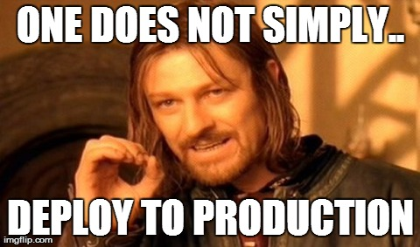
Current state of deployments

Slide 6
Perpetrators of bad deployments

Slide 7
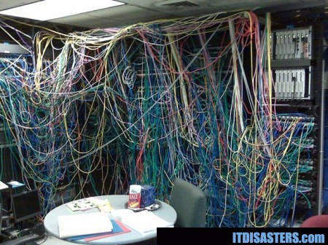
This scenario is more likely (metaphorically)

Slide 8
My own experiences with deployments
Excel spreadsheet check lists
Email as documentation
When something goes wrong, everyone is frantically trying to figure out the problem
Rolling back to previous version takes longer especially if database changes need to be reverted
Multiple deployment types (web,db,ssrs,services,etc.) drastically prolong deployment
Public deployments done on Saturday night (late)
Conference call with a few developers
Everyone smoke tests the site

Slide 9
TFS Automation at Accenture
November of 2013 – Present – testing 2 products:
InCycle/Microsoft Release Management 2013 for Visual Studio
Octopus Deploy
After 3 months of testing, Octopus was the winner
Why not Release Management 2013?

Slide 10
Octopus over Release Management
RM – all deployments use TFS Drop folder; no central storage
RM – fractured logging; Octopus – seamless logging across servers;
RM – required one consistent port for all servers, agents and desktop clients (not available in larger organization with complex networks)
RM – desktop client only! web client only for approvals
RM – high pricing! Octopus – simple and very affordable
RM – deployments by default are serial; parallel you have to specify each servers steps

Slide 11
Meh. Our manual deployments are just fine..
Do you know exactly what’s in your environments?
Can you show an audit trail of everything that happened?
Can you quickly deploy a prior version without rebuilding?
Are your deployments secure from build to deployment?
Are you sure no one has altered any files between deployments?
Can you deploy or promote the exact same binaries quickly?
Who approved the deployment?
Can you continuously deploy with no intervention?
Can you do all of this with a few mouse clicks?

Slide 12
What can Octopus Deploy do that we can’t?
Audit everything that happens (automatically) on all servers and view in real-time
Easily promote exact same binaries from one environment to another
Change versioned binaries and deploy quickly
Deploy Windows .NET Web Apps, Windows Services, MSI installers, SSRS reports, SSIS packages, SharePoint packages, database scripts and web services
Change configuration files based on environment, machine, server role or step
Can do continuous deployments (version deployments)
Deploy to servers in parallel or serial (aka rolling deployments)

Slide 13
How does Octopus work?
Octopus uses NuGet packages as a storage mechanism
Using the OctoPack, TFS build template can generate NuGet packages and push them automatically to a specified NuGet server
NuGet server stores compiled projects as NuGet packages available for deployment at any time
Agents (tentacles) are installed on servers you want to deploy to
You can define your environments and assign servers (tentacles)
A deployment process will fetch your NuGet package and run the defined steps in parallel (across servers)

Slide 14
How does Octopus work? (con’t)

Slide 15
Why is Octopus better?
NuGet is the better approach
No need to recompile projects (if you need to rollback)
Centralized storage; TFS build drop folders insecure and waste storage space
Prevent tampering of config files with locked-down NuGet server (security)
Force process over manual changes (best practices)
NuGet gallery for all (internally or externally)

Slide 16
Why is Octopus better (con’t)
Powershell is the best choice for Windows deployments
Octopus audits all PowerShell output
Tailor your deployment without WMI or batch scripts
DSC (desired state configuration) – next big thing in PowerShell
Can deploy to Azure and Amazon instances
Can use to deploy SharePoint, SSRS, etc.

Slide 17
Why is Octopus better (con’t)
SQL Server not required!
Uses Embedded RavenDB
IIS not required!
Uses NancyFX Self-hosted
Octopus REST API
They consistently use their own API throughout all components
Octo.exe, DbUp, Octopus Step Template Library are all open source

Slide 18
Other features of Octopus
Agents (tentacles) can use any port to connect to Octopus Server
Many company networks may have very restrictive port access
Able to do Continuous Deployment on Check-in or scheduled releases
Octo.exe can be called to trigger release on Octopus Server
Integrates with Active Directory or own user database
Active community suggestion forum
Rapid development schedule
Everything uses PowerShell

Slide 19
How to configure Octopus Deploy?
OctoPack – a NuGet package to install for your project
Hooks into TFS build template to create NuGet package and push to server
NuSpec file – a file that tells what files to store in the NuGet package
Use command line “nuget.exe spec <project name>” to create nuspec file in project folder
Change TFS build template (MSBuild arguments)
/p:RunOctoPack=true /p:OctoPackPublishApiKey=<YourCustomApiKey> /p:OctoPackPublishPackageToHttp=<YourNuGetServerUrl>
Configure Deployment process for deploying your NuGet package

Slide 20
How to configure Octopus Deploy? (con’t)
When your project NuGet package is in NuGet server feed, Octopus can see the package and deploy to specific environment/servers
Define deployment process per project
Configure config file variable replacements
Can configure manual interventions for approval/denial
Email notifications
Downloadable Step Templates from library.octopusdeploy.com

Slide 21
What about “X” type of deployments?
Database deployments
Recommended practice is to have a Windows Console app that is a script runner; Octopus has free dll (DbUp) available on GitHub/NuGet that allows Windows Console to execute SQL scripts in folder in console app
Check out http://dbup.github.io
SSRS deployments
GitHub project “Deploy-SSRSProject.ps1” has PowerShell script to deploy reports to Reporting Services asmx web service target
Check out https://gist.github.com/jstangroome/3043878
SharePoint deployments
PowerShell scripts are your friend

Slide 22
Demo

Slide 23
Warts and road bumps
NuGet NuGet.exe and NuGet servers
ProGet (free and paid version) – still having issues pushing using latest NuGet.exe
Developers seem to break compatibility or have numerous unaddressed issues
Each new version has it’s issues; must be careful in using latest and greatest (pushing only)
NuGet versioning
Need to find unique way of versioning your packages
IIS configuration
Default NuGet upload size is 30MB; must configure IIS for larger packages
http://help.octopusdeploy.com/discussions/problems/184-30mb-default-maximum-nuget-package-size

Slide 24
Yeah, well, what about new stuff?
Constant community feedback at:
https://octopusdeploy.uservoice.com/
Just announced roadmap (based from community feedback)
http://octopusdeploy.com/roadmap
Aggressive schedule (2-4 week sprints)
For reference, since January of this year, they’ve had 4 releases (2.0 to 2.4)

Slide 25
Well, they must be pricey, right?
Perpetual license! Once you buy it, it’s yours plus one year of updates
Renewals are for updates and support
Renewal pricing is 50% of original cost
Octopus Licensing (* = unlimited):
Free $0 5 projects 10 agents 5 users
Professional $700 20 projects 20 agents 20 users
Team $2000 60 projects 60 agents 60 users
Enterprise $5000 * projects * agents * users
For more information, check out http://octopusdeploy.com

Slide 26
Conclusions
Octopus Deploy is the clear cut path to reliable, maintainable and fast deployments
Octopus Deploy’s components separates it from any other solution available; end user experience very good without configuration alone
Other solutions are either too cumbersome, heavy-handed or outdated
Octopus Deploy’s development transparency and velocity easily surpasses other competitors
Pricing is extremely affordable

Slide 27
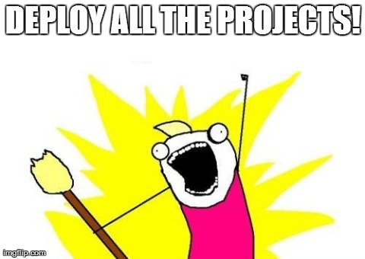
Go forth and deploy!

